Slide 1

Advanced course
Lesson 30
DIY coures（8）
DIY Accordion
YahBoom Croco:Kit tutorial

Slide 2
Advanced course
Content
Part1
Part 2
Part3
Part 4
Part 5
Learning goals
Preparation
Connection
Search for blocks
Combine blocks
YahBoom Croco:Kit tutorial

Slide 3
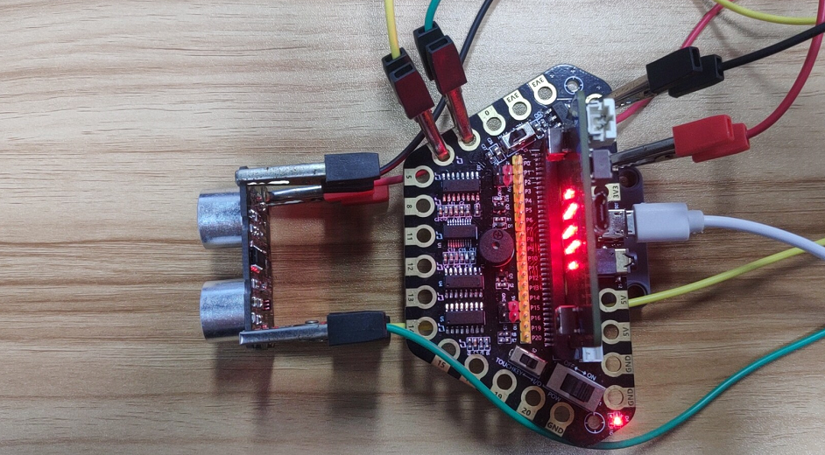
Advanced course
Part 1
Learning goals
After downloading the program, you can see the microbit LED dot matrix display ‘Hello!’,we can put our hand in front of the ultrasonic module, when the ultrasonic module detects different distances, buzzer will play different tones, the effect of playing the piano by hand can be achieved.
YahBoom Croco:Kit tutorial

Slide 4
Advanced course
Part 2
Hardware:
● 1 X Micro:bit Board
● 1 X Micro USB Cable
● 1 X Diamond breakout
● 4 X Alligator clip
● 1 X Ultrasonic module
● 1 X PC
Preparation
Mode 1 online programming: First, we need to connect the micro:bit to the computer by USB cable. The computer will pop up a USB flash drive and click on the URL in the USB flash drive: http://microbit.org/ to enter the programming interface. Add the Yahboom package: https://github.com/lzty634158/Croco-Kit to program.
Mode 2 offline programming: We need to open the offline programming software. After the installation is complete, enter the programming interface, click【New Project】, add Yahboom package: https://github.com/lzty634158/Croco-Kit , you can program.
YahBoom Croco:Kit tutorial

Slide 5
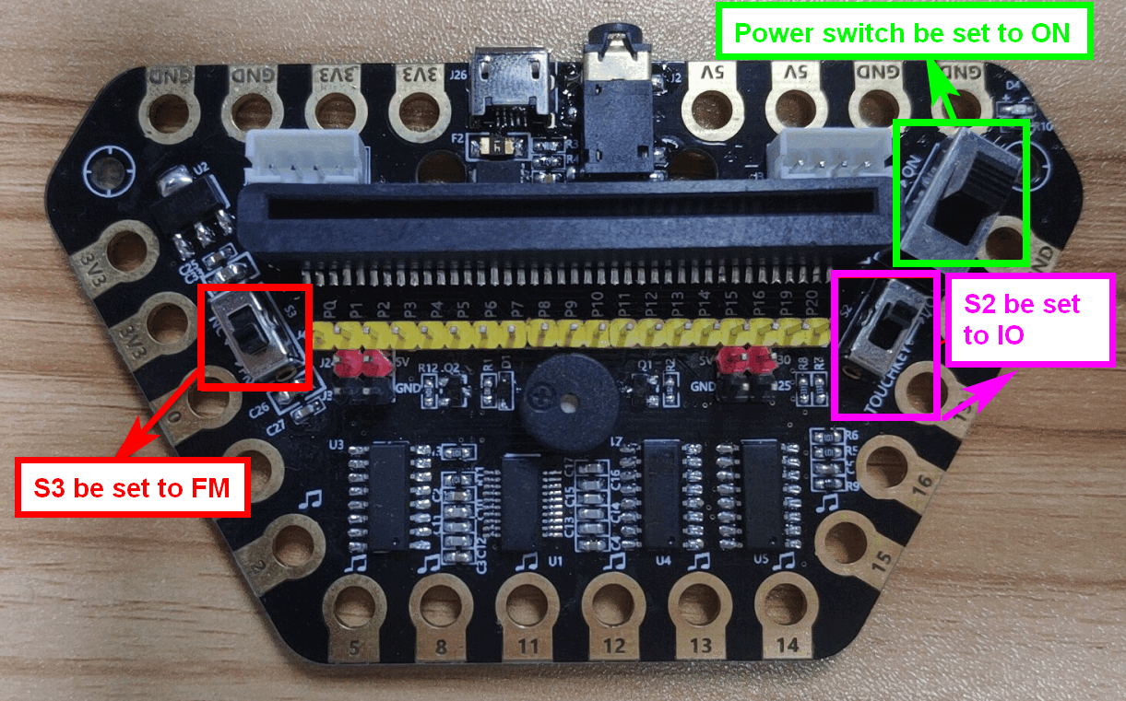
Advanced course
Part 2
Preparation
! ! !Note: S1 be set to the ON, S2 be set to the IO, and S3 to the FM.
YahBoom Croco:Kit tutorial

Slide 6
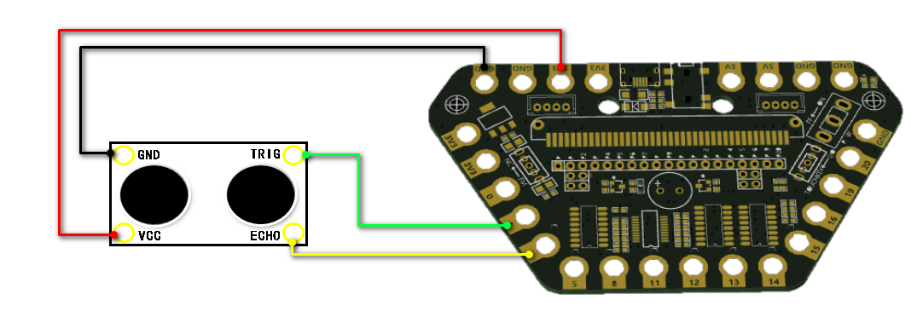
Advanced course
Part 3
Expansion board | Ultrasonic Module
P1 | TRIG
P2 | ECHO
3.3V | VCC
GND | GND
Connection
YahBoom Croco:Kit tutorial

Slide 7
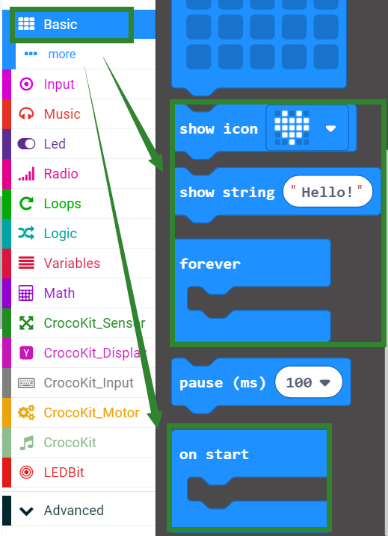
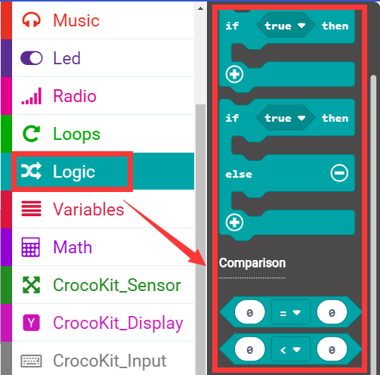
Advanced course
Part 4
Search for blocks
YahBoom Croco:Kit tutorial

Slide 8
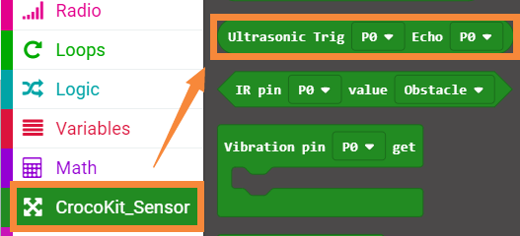
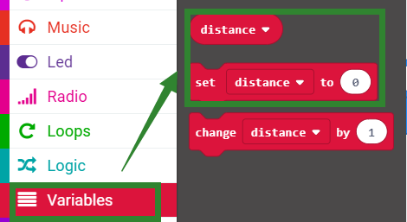
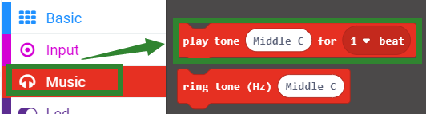
Advanced course
Part 4
Search for blocks
YahBoom Croco:Kit tutorial

Slide 9
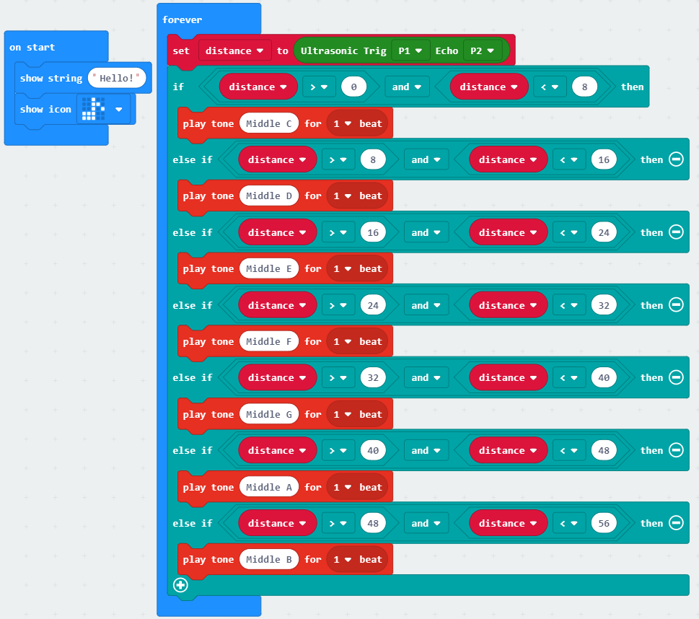
Advanced course
Part 5
Combine blocks
YahBoom Croco:Kit tutorial

Slide 10
Advanced course
Advanced course
Thank you ！
Powered by YahBoom
YahBoom Croco:Kit tutorial

